Slide 1
Mini project
PREDICTION OF MEDICINE SYMPTOMS
- "Turning Symptoms into Solutions: Your Personalized Medicine Awaits."

Slide 2
TEAM MEMBERS
JAHNAVI GUNTUBOINA(1602-22-737-018)
VINITA MANI ISUKAPUDI(1602-22-737-062)
AJAY RAGULA(1602-22-737-003)

Slide 3
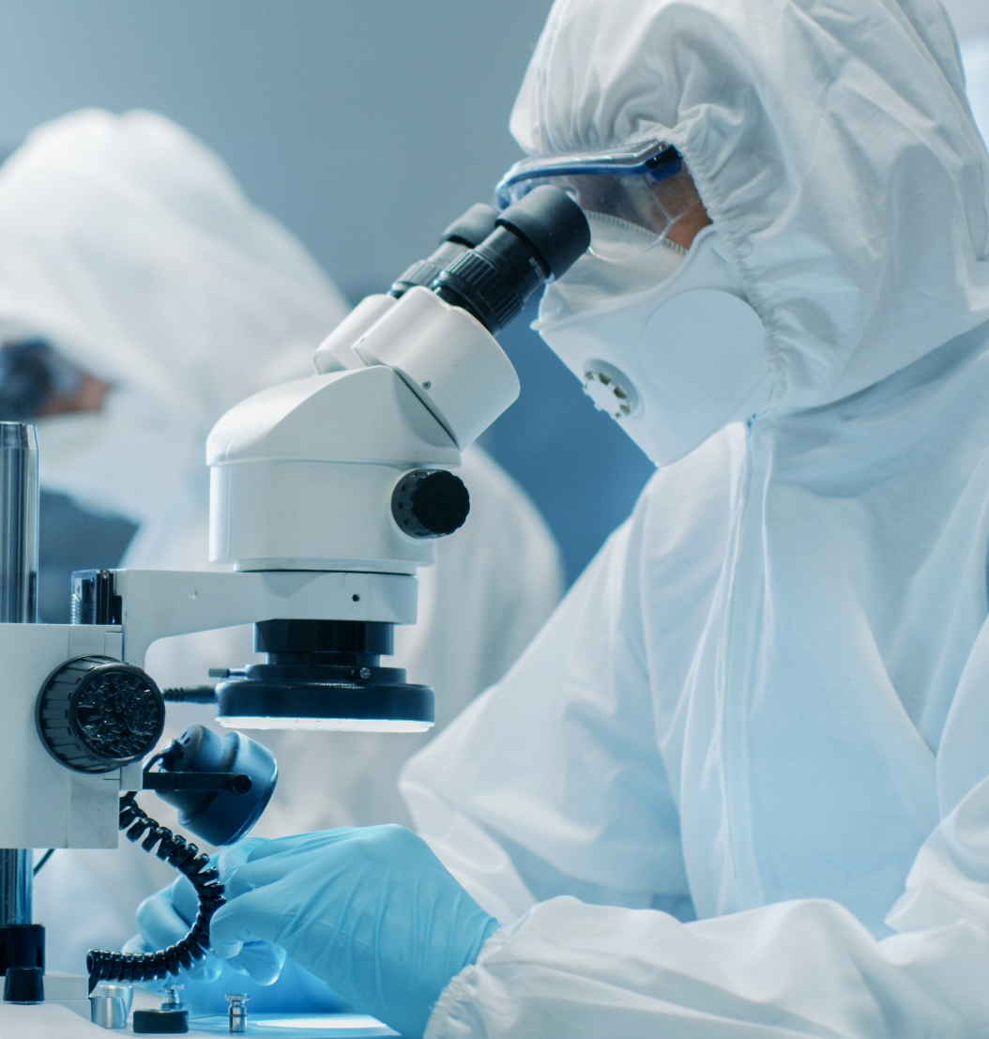
agenda
ABSTRACT
OBJECTIVES
INTRODUCTION
REQUIREMENTS
DIAGRAMS AND OUTPUTS
FUTURE WORK

Slide 4
ABSTRACT
The proposed project aims to develop a web-based medicine prediction system that assists users in identifying suitable medications based on provided symptoms and medical history. The system leverages a machine learning model, specifically a decision tree classifier, to predict appropriate medicines. Users input their symptoms and medical history through a user-friendly web interface. The system processes this information, applies the trained model, and provides personalized predictions for the most relevant medications. The web application not only enhances user accessibility to medical information but also showcases the potential of machine learning in healthcare decision support systems. Additionally, the system prioritizes user privacy and data security by employing secure web practices and anonymizing sensitive information.

Slide 5
OBJECTIVES
1.DEVELOP USER –FRIENDLY INTERFACE:
CREATE AN INTUITIVE AND USER-FRIENDLY WEB INTERFACE THAT ALLOWS USERS TO INPUT
SYMPTOMS AND MEDICAL HISTORY EASILY.
2.PROVIDE ACCURATE MEDICINE PREDICTIONS:
OPTIMIZE THE MACHINE LEARNING TO PROVIDE ACCURATE PREDICTIONS
FOR MEDICINES BASED ON SYMPTOMS, MEDICAL HISTORY AND AGE GROUP.
3.ENABLE FEEDBACK MECHANISM:
IMPLEMENT A FEEDBACK MECHANISM TO INFORM USERS ABOUT THE RELIABILITY
OF PREDICTIONS.
ENCOURAGE USERS TO CONSULT HEALTHCARE PROFESSIONALS FOR
COMPREHENSIVE DIAGNOSES AND TREATMENT PLANS.

Slide 6
4.IMPLEMENT MACHINE LEARNING MODEL:
BUILD,TRAIN,AND DEPLOY A MACHINE LEARNING MODEL,SPECIFICALLY A DECISION
TREE CLASSIFIER,TO PREDICT MEDICINES BASED ON USER INPUTS.
UTILIZE A DIVERSE AND REPRESENTATIVE DATASET FOR MODEL TRAINING
TO ENHANCE ACCURACY AND GENERALIZATION.
5.INTEGRATE EDUCATIONAL RESOURCES:
INCLUDE RELEVANT EDUCATIONAL RESOURCES WITHIN THE WEB APPLICATION TO
INFORM USERS ABOUT SUGGESTED MEDICATIONS AND GENERAL HEALTH ADVICE.
EMPOWER USERS WITH KNOWLEDGE TO MAKE INFORMED DECISIONS ABOUT
THEIR HEALTH.

Slide 7
INTRODUCTION
In the era of technological advancements, the intersection of healthcare and artificial intelligence presents unprecedented opportunities to enhance medical decision-making and accessibility to healthcare information. The “MedIMENTOR” Web Application is a groundbreaking project that seeks to leverage machine learning to assist users in identifying appropriate medications based on their reported symptoms and medical history. This initiative is driven by the goal of empowering individuals with personalized health insights, promoting informed decision-making, and augmenting the accessibility of medical information.

Slide 8
Significance of the Project: The medi mentor stands at the forefront of utilizing technology to bridge gaps in healthcare accessibility. By amalgamating user-provided health information with advanced machine learning algorithms, the project aims to democratize access to preliminary healthcare insights. Users, irrespective of their geographical location, can benefit from personalized medication predictions, allowing for quicker decision-making and potentially reducing the time required for professional consultations. Objectives:

Slide 9
SOFTWARE AND HARDWARE REQUIREMENTS
SOFTWARE REQUIREMENTS:
1.FRONTEND TECHNOLOGIES(HTML,CSS)
2.INTEGRATED DEVELOPMENT ENVIRONEMNT(IDE)
3.VERSION CONTROL(GIT)
HARDWARE REQUIREMENTS:
1.SERVER
2.STORAGE
3.BACKUP SYSTEMS

Slide 10
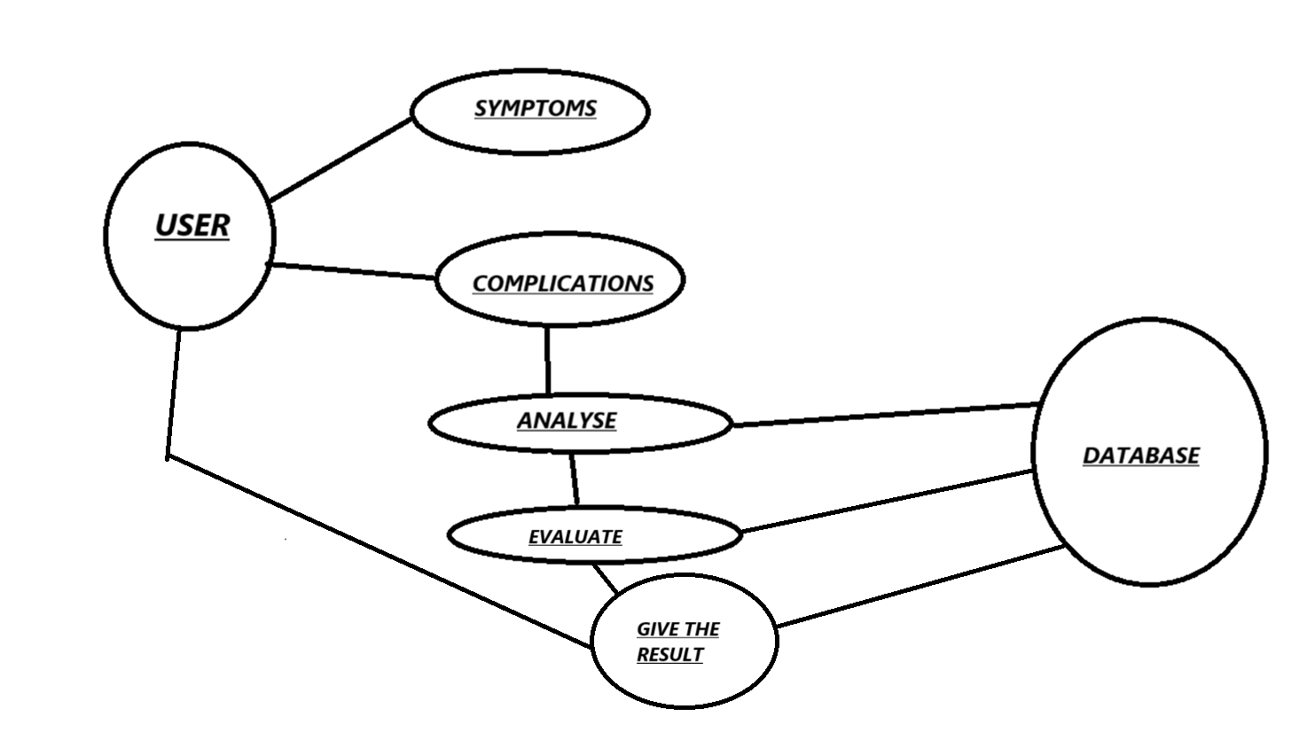
USE – CASE DIAGRAM

Slide 11
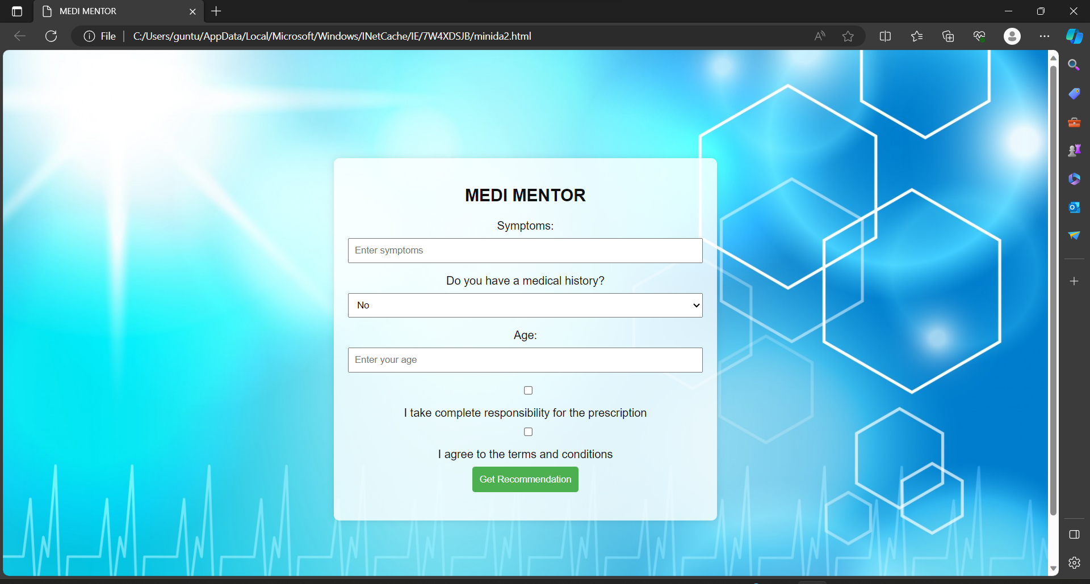
OUTPUT

Slide 12
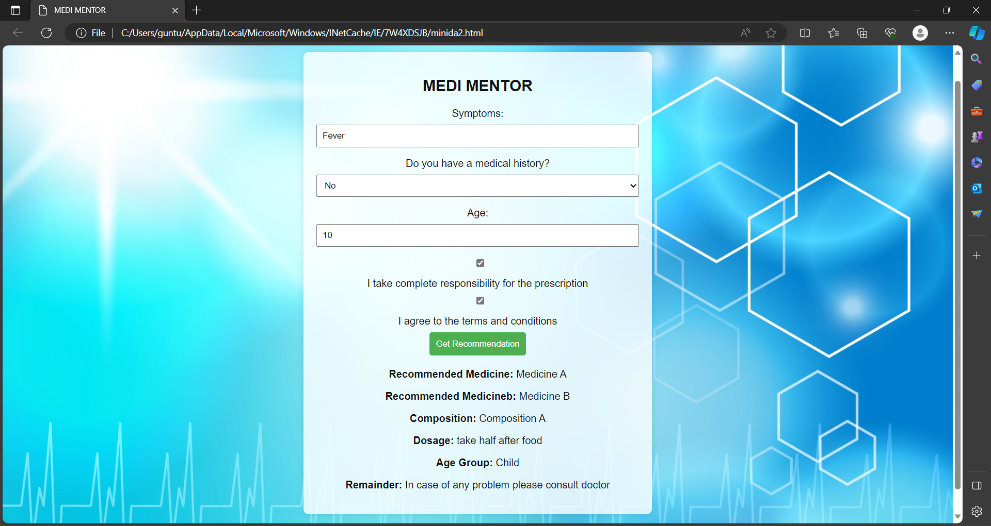

Slide 13
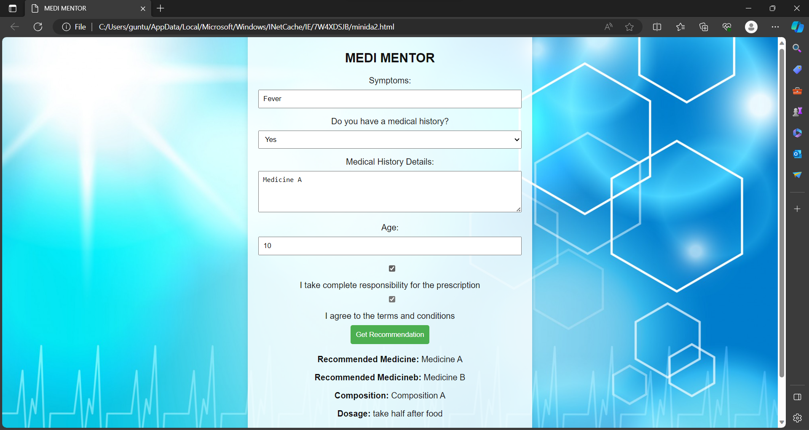


Slide 14
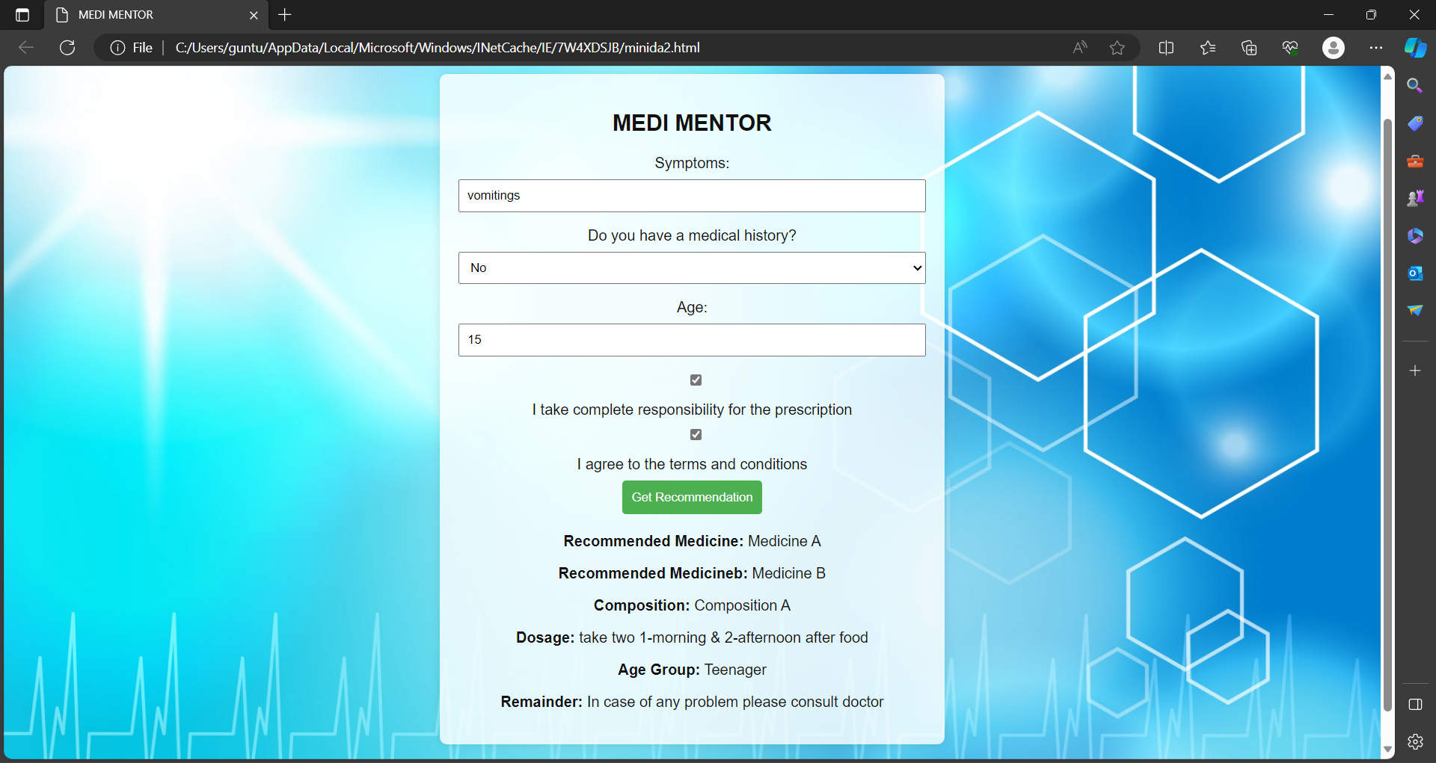

Slide 15


Slide 16
FUTURE WORK
The MEDIMENTOR serves as a pioneering step towards leveraging artificial intelligence in healthcare decision support systems. In envisioning the future of this project, there are several exciting avenues for development and enhancement. Foremost among these is the continuous refinement of the machine learning models driving medication predictions. Exploring advanced techniques, such as ensemble methods and deep learning, can further elevate the accuracy and applicability of the predictions. Additionally, the integration of real-time medical data sources ensures that users receive the latest information on medications and healthcare trends. Analyzing user feedback becomes pivotal for iterative improvement, and the application of natural language processing can enhance the system's ability to interpret nuanced user inputs. Future development may extend the application to mobile platforms, encompassing features like medication dosage recommendations, potential side effects, and interactions. Furthermore, collaboration with healthcare professionals, integration with telemedicine platforms, and the provision of personalized health plans can transform the application into a comprehensive healthcare companion. The commitment to ethical considerations, compliance with regulations, and global expansion further solidify the application's role in democratizing access to healthcare insights and fostering a more informed and connected healthcare ecosystem.

Slide 17
Thank you

